Slide 1
Chapter 2 : Stress and Strain- Axial Loading
Normal Strain under axial loading
Stress-strain diagram
Hook’s Law-Modulus of Elasticity
Elastic Versus Plastic behavior of materials
Fatigue*
Deformation of members under axial loading (Deformation=PL/AE)

Slide 2
Repeated Loadings: Fatigue
If the stress in the specimen does not exceed the elastic limit of the material, the specimen returns to its initial condition when the load is removed.
When loadings are repeated thousands of times, rupture will occur at stress much lower than the static breaking strength.
This phenomenon is known as fatigue.
A fatigue failure is of a brittle nature, even for ductile materials.

Slide 3
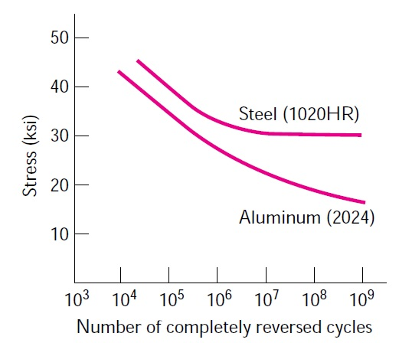
Repeated Loadings: Fatigue

Slide 4
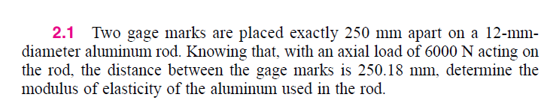

Slide 5
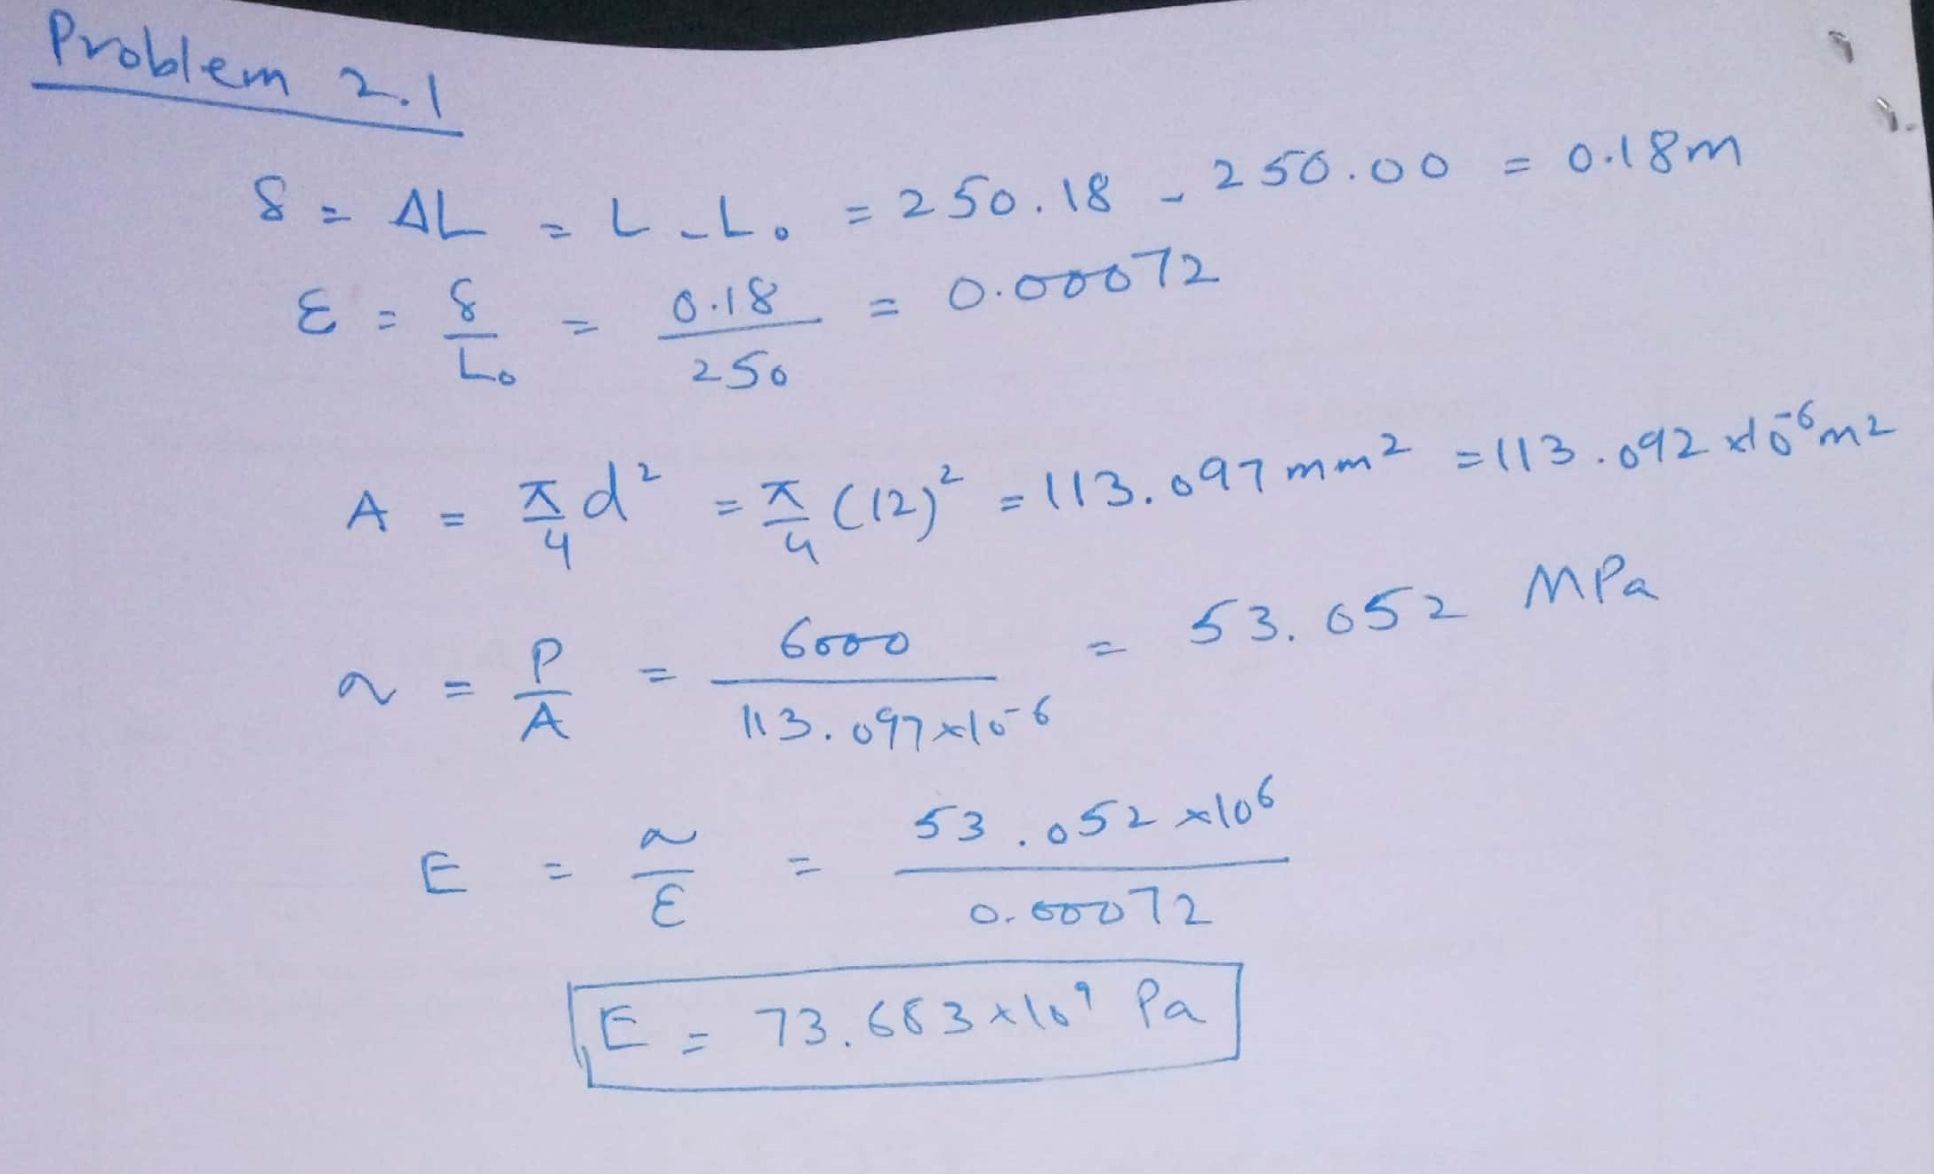

Slide 6
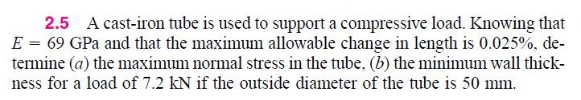

Slide 7
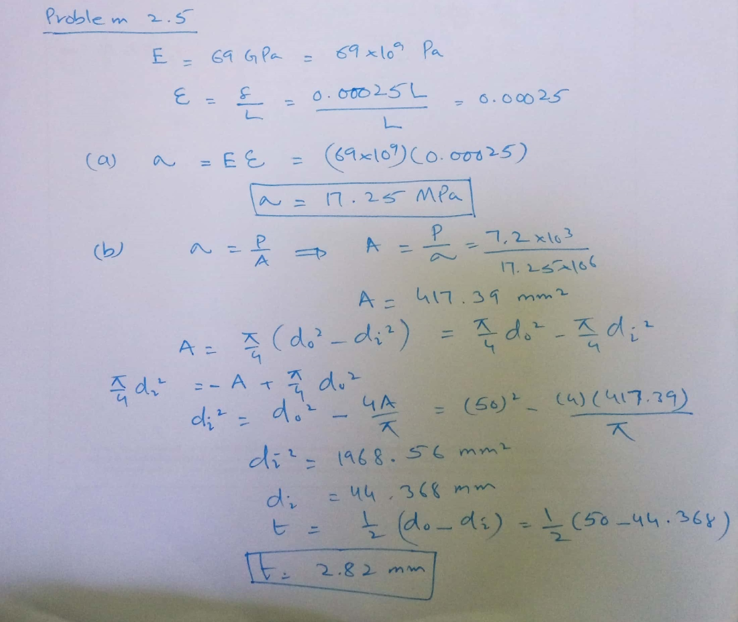

Slide 8
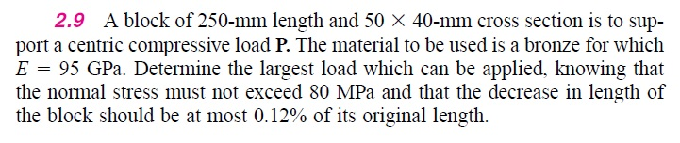

Slide 9
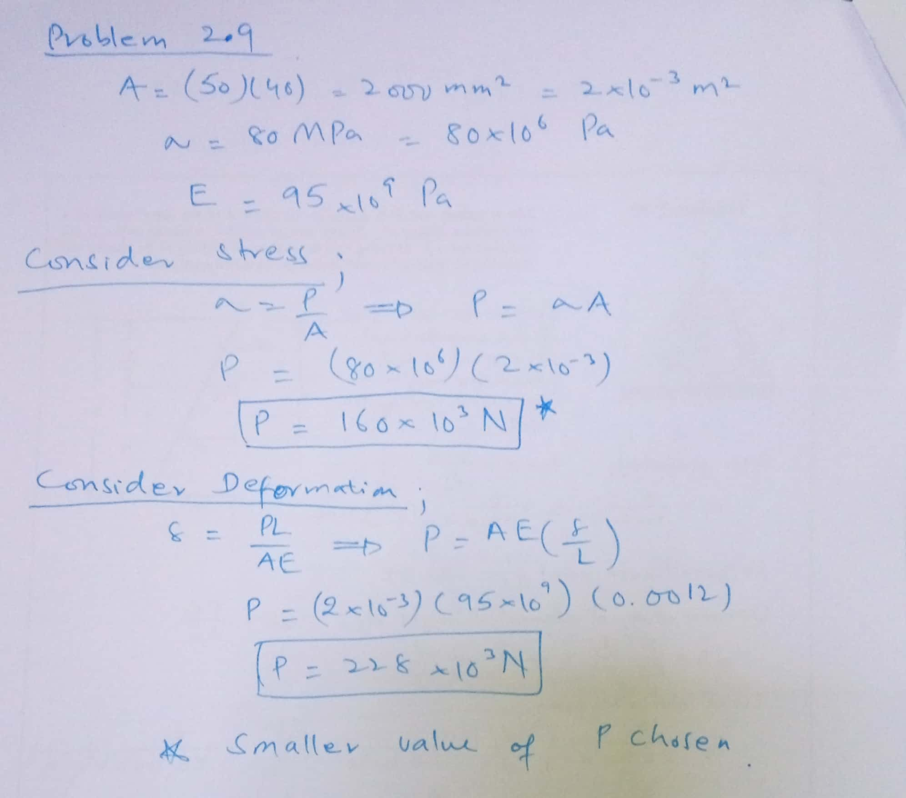

Slide 10
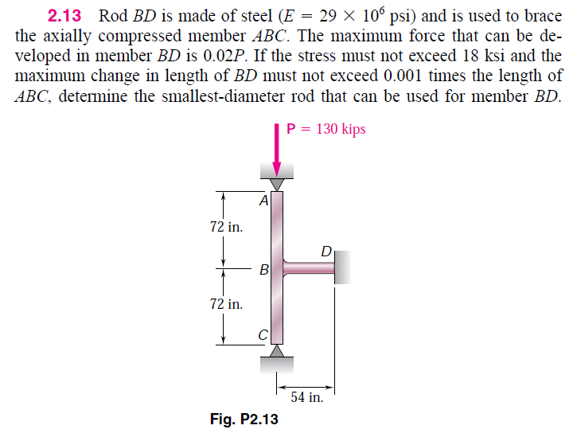

Slide 11
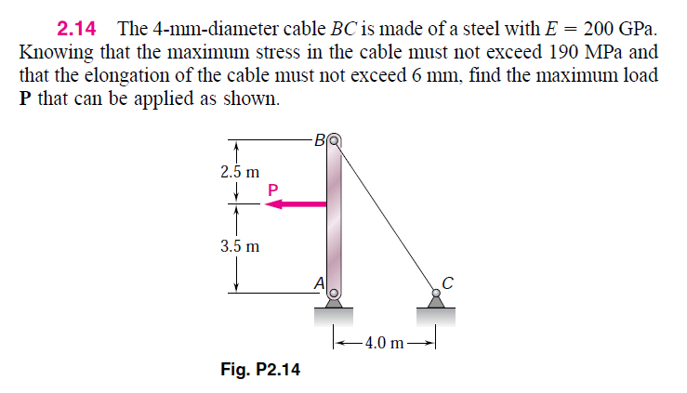

Slide 12
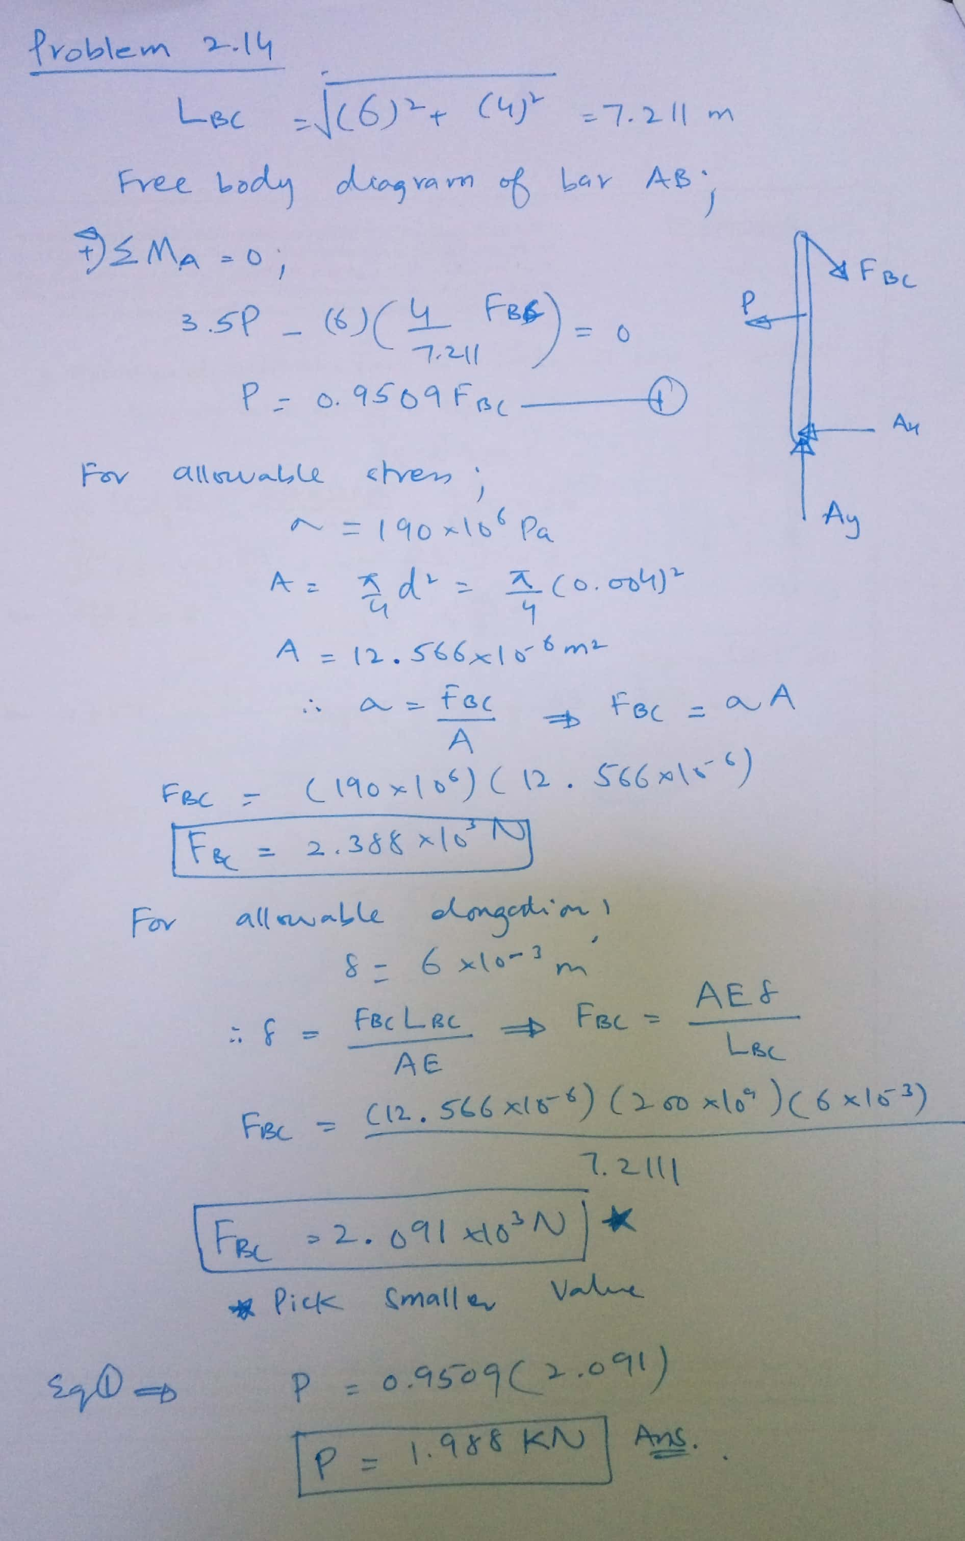

Slide 13
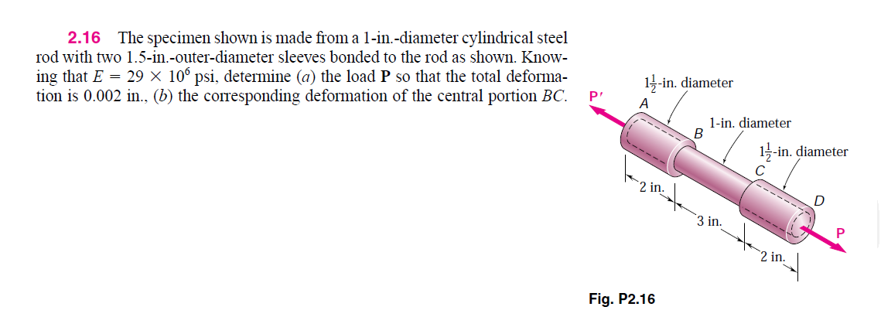

Slide 14
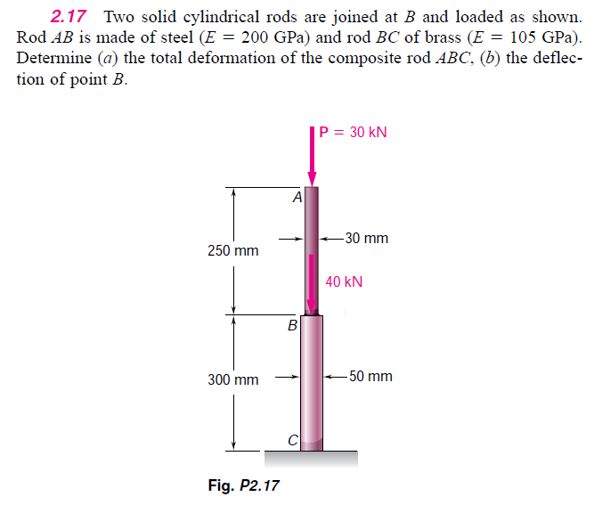

Slide 15
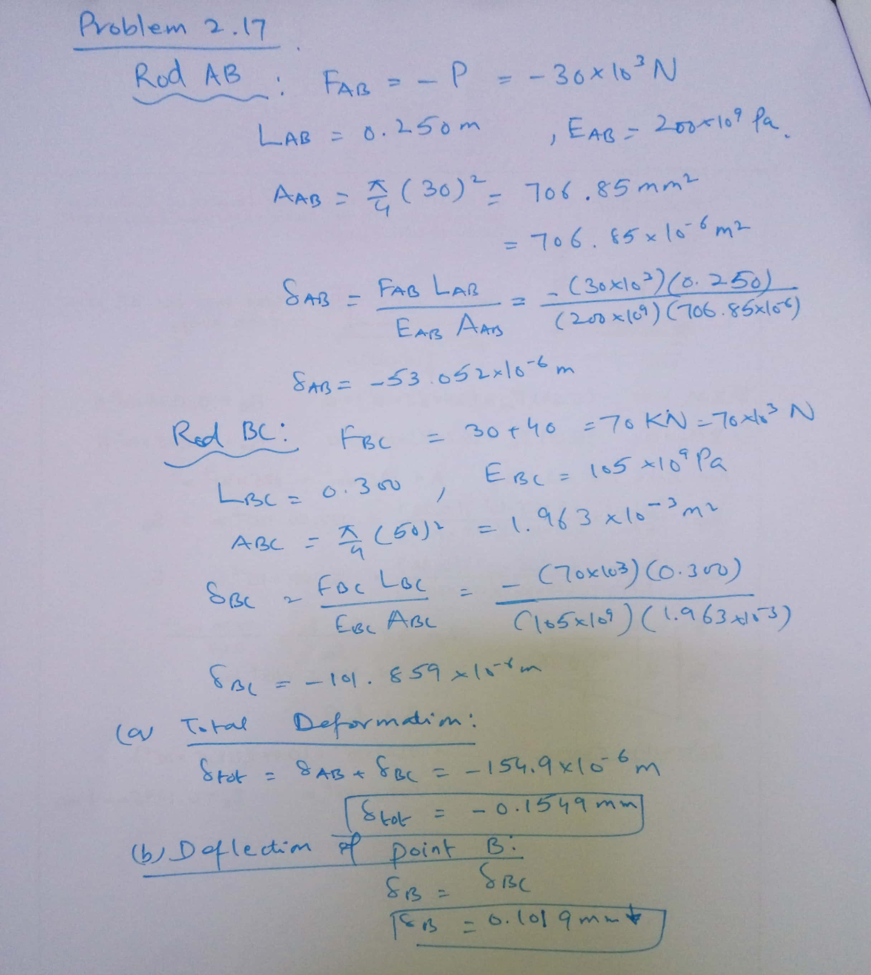

Slide 16
Chapter 2 (End problems for part I)
Problem no. 2.1-2.20 (5th Ed of text Book, SI units preferably)

